Slide 1

Mughira Ghafoor
Student of Condensed Matter Physics
Student I’d 2001110220
Wide Band Gap Semiconductor

Slide 2

Technology and Metrology of new Electronic Materials and Devices
The traditional MOSFET consists of a silicon substrate,
a highly doped polysilicon gate electrode,
a gate dielectric of ${SiO}_{2}$,
doped source and drain.

Slide 3
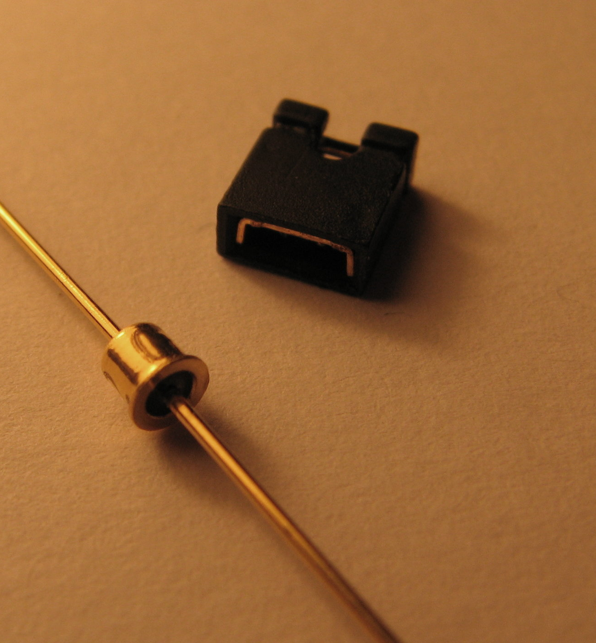


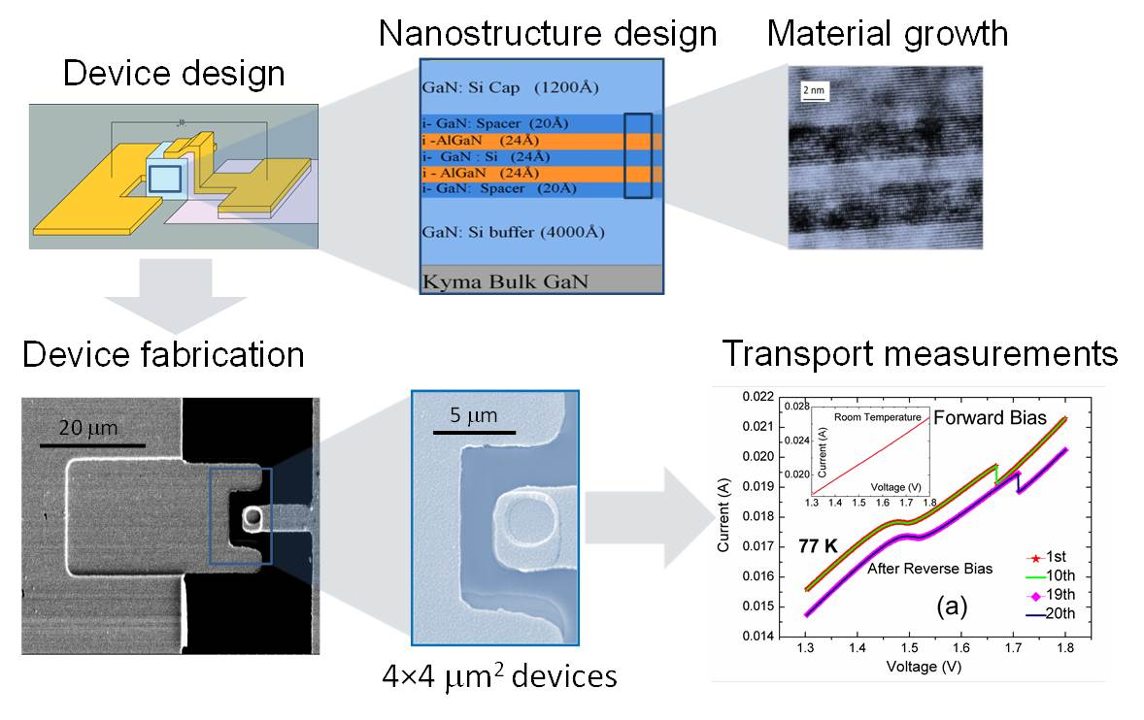
Devices
PCs and mobile phones to control systems found in automobiles and jet airplanes.
devices include memories based on nanocrystals, thin semiconductors for resonant tunnelling diodes,
quantum dots for cellular automata carbon nanotube or bottom-up nanowire transistors and single-electron transistors.
The basis of molecular electronic devices is the behavior of the electronic properties of single molecules or monolayers.

Slide 4
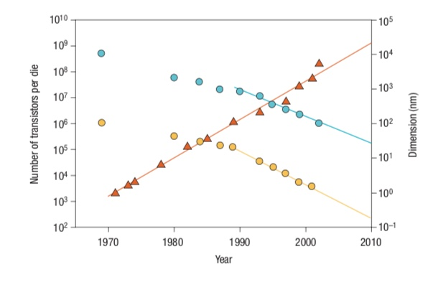
Technology and metrology of new electronic materials and devices
The number of transistors (red triangles),
Transistor minimum lateral feature size (blue circles),
Transistor minimum physical oxide thickness (yellow circles).

Slide 5
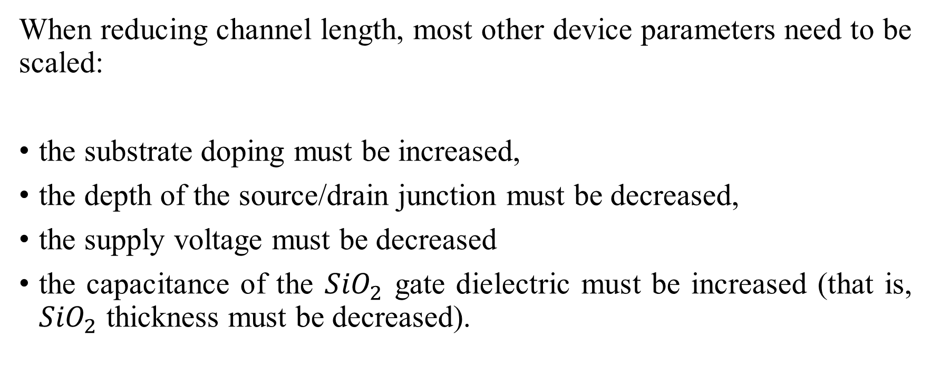
To maintain, or improve the device performance
When reducing channel length, most other device parameters need to be scaled:
the substrate doping must be increased,
the depth of the source/drain junction must be decreased,
the supply voltage must be decreased
the capacitance of the ${SiO}_{2}$ gate dielectric must be increased (that is, ${SiO}_{2}$ thickness must be decreased).

Slide 6
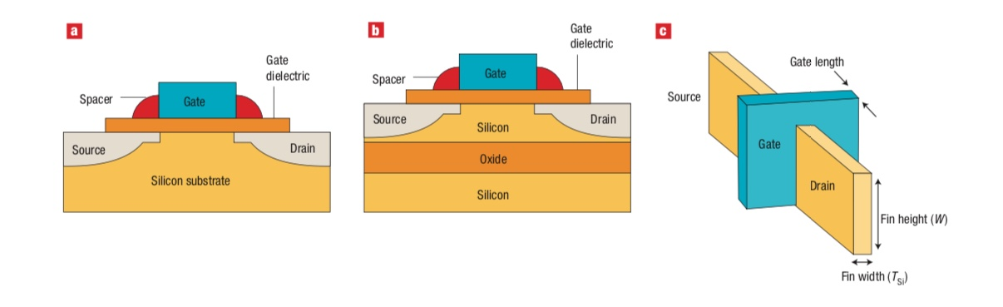
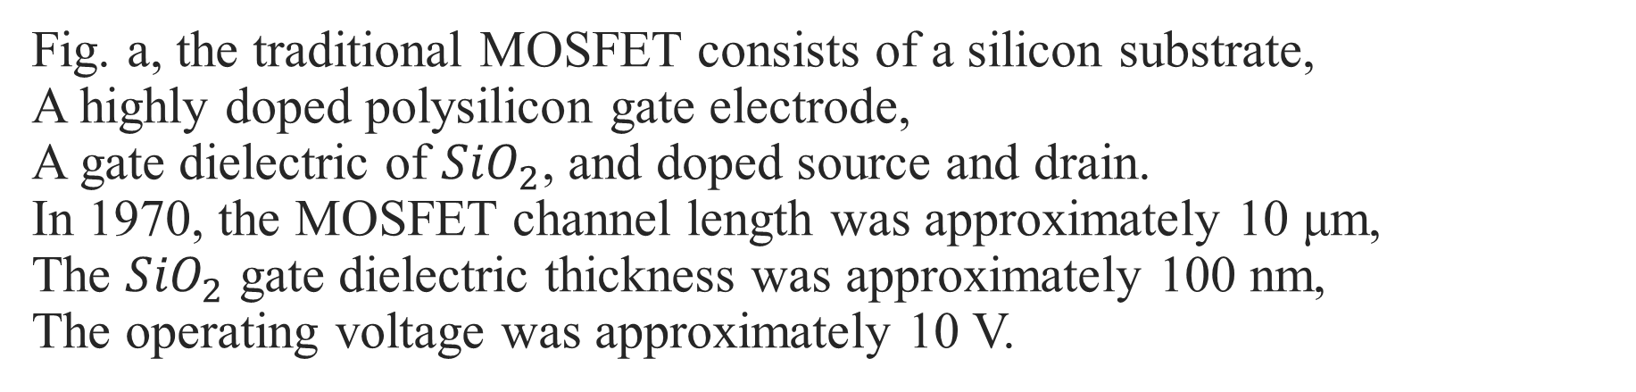
Fig. a, the traditional MOSFET consists of a silicon substrate, A highly doped polysilicon gate electrode, A gate dielectric of ${SiO}_{2}$, and doped source and drain. In 1970, the MOSFET channel length was approximately 10 μm, The ${SiO}_{2}$ gate dielectric thickness was approximately 100 nm, The operating voltage was approximately 10 V.

Slide 7
Fig. b, where the active silicon is on a layer of thick silicon dioxide, which decreases the junction capacitance from the source/ drain to the substrate, thereby increasing the speed of the FET.

Slide 8
Fig. c, A finFET is a three-dimensional version of a MOSFET. The gate electrode wraps around a confined silicon channel providing improved electrostatic control of the channel electrons. Finally, the metal must not degrade the electrical properties of the underlying high-κ dielectric.

Slide 9
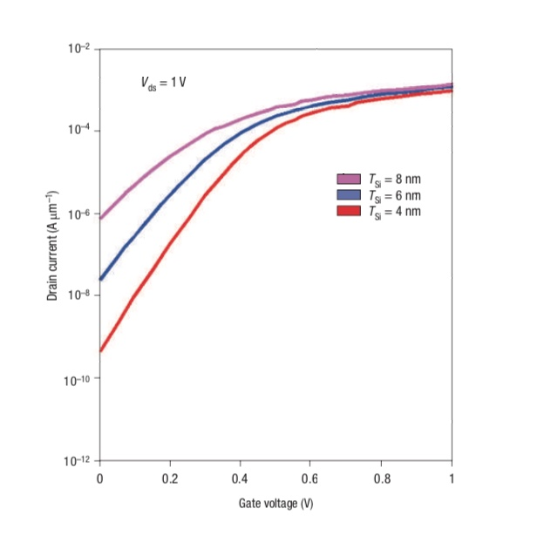
Drain current versus gate voltage characteristics of a finFET for different values of fin width (TSi)
The increase of the characteristic slope at low gate voltages with decreasing TSi is due to increased electrostatic control of the gate over carriers in the channel.
The strong sensitivity of the current at 0 V on TSi (almost one order of magnitude in current for every 2nm change in TSi).
The need for highly precise dimensional measurements with precision much less than 1nm.

Slide 10
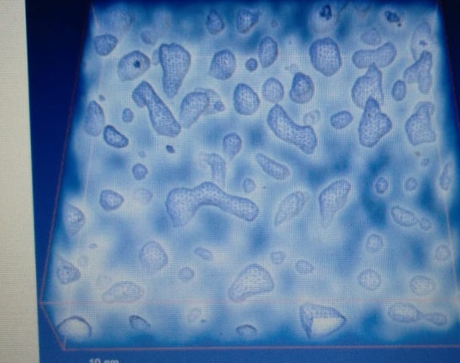

The structure of silicon quantum dots. Tomographic reconstruction of the silicon plasmon signal at 17 eV, visualized by volume rendering (white ‘fog’). An iso-surface at fixed threshold (blue shapes) for silicon quantum dots embedded in ${SiO}_{2}$. In modelling and predicting the behavior of devices based on silicon quantum dots, it is largely assumed that the quantum dots are perfectly spherical. These results indicate that the silicon dots are not perfectly spherical.

Slide 11
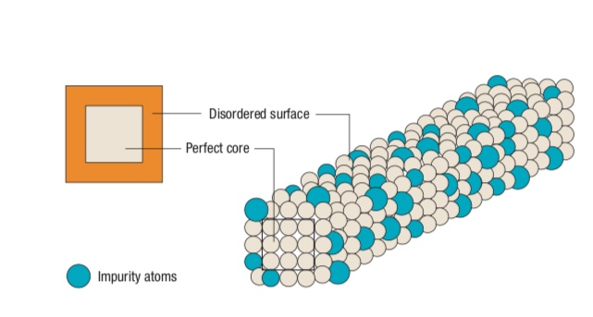
Shell-doping of nanowires
Enhanced electron mobility.
Give dopant profiles on the atomic scale.
Small amounts of metal catalyst used to grow the nanowires can migrate into the nanowire and affect the electrical properties.

Slide 12
Techniques used
Photoelectron spectroscopy and inverse photoelectron spectroscopy have been used to map the valence and electron density of states in thin dielectric films.
One- and two photon photoelectron spectroscopy has also been used to determine the electronic structure of self-assembled monolayers around the Fermi level.
Scanned probe techniques such as scanning Kelvin probe microscopy and versions of scanning tunnelling microscopy can provide information on local electronic structure.

Slide 13
Aim of Study
Metrology has been an important infrastructure enabling the exponential increase of device density and exponential decrease of device dimension.
New nanoscale materials and devices will be required to sustain this technological revolution but the extreme sensitivity of the electronic properties of these devices to their nanoscale physical properties and the insertion of radically new materials present significant challenges to metrology.
The ability to measure the physical, chemical and electronic properties of these new materials and devices will become even more critical in continuing the advance of the MOS and finding technologies to extend or replace it.

Slide 14


